Slide 1

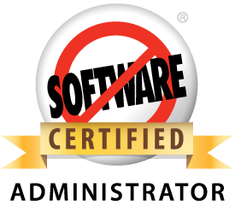



Transitioning from MSSQL to Force.com
Building upon your skillset to work with Force.com
Andy Boettcher, Demand Chain Systems, Senior CRM Advisor
@andyboettcher
in/andyboettcher
andyboettcher.com

Slide 2
Safe harbor
Safe harbor statement under the Private Securities Litigation Reform Act of 1995:
This presentation may contain forward-looking statements that involve risks, uncertainties, and assumptions. If any such uncertainties materialize or if any of the assumptions proves incorrect, the results of salesforce.com, inc. could differ materially from the results expressed or implied by the forward-looking statements we make. All statements other than statements of historical fact could be deemed forward-looking, including any projections of product or service availability, subscriber growth, earnings, revenues, or other financial items and any statements regarding strategies or plans of management for future operations, statements of belief, any statements concerning new, planned, or upgraded services or technology developments and customer contracts or use of our services.
The risks and uncertainties referred to above include – but are not limited to – risks associated with developing and delivering new functionality for our service, new products and services, our new business model, our past operating losses, possible fluctuations in our operating results and rate of growth, interruptions or delays in our Web hosting, breach of our security measures, the outcome of intellectual property and other litigation, risks associated with possible mergers and acquisitions, the immature market in which we operate, our relatively limited operating history, our ability to expand, retain, and motivate our employees and manage our growth, new releases of our service and successful customer deployment, our limited history reselling non-salesforce.com products, and utilization and selling to larger enterprise customers. Further information on potential factors that could affect the financial results of salesforce.com, inc. is included in our annual report on Form 10-Q for the most recent fiscal quarter ended July 31, 2012. This documents and others containing important disclosures are available on the SEC Filings section of the Investor Information section of our Web site.
Any unreleased services or features referenced in this or other presentations, press releases or public statements are not currently available and may not be delivered on time or at all. Customers who purchase our services should make the purchase decisions based upon features that are currently available. Salesforce.com, inc. assumes no obligation and does not intend to update these forward-looking statements.

Slide 3
Agenda
What exactly are we doing here today?
Who are you?
Who am I?
Terminology
Tools
Tips and Tricks
Ping your peers / Q & A

Slide 4

Who are you?
Are you possibly…?
Looking to start working in Force.com
Researching integration
Loading data
Let’s hear from you!

Slide 5
Who am I?
Andrew Boettcher
Background
Systems Engineer / Architect (MCSE)
.NET Software Developer
MSSQL DBA
Rumblings and Aspirations
Senior CRM Advisor, Demand Chain Systems (Minnesota)
Twin Cities (MN) Developer User Group Leader
Evangelizing Force.com to anyone who will listen!

Slide 6
Terminology Overview
MSSQL |  | Force.com
Table | = | Standard / Custom sObject
Field | = | Standard / Custom Field
Field Integrity | = | Validation Rules
Relationship | = | Relationship
Stored Procedure | = | Workflow and APEX Class
Trigger | = | APEX Trigger
Index | = | Index, but not user customizable
View | = | Not available

Slide 7

Table
MSSQL Table = Force.com sObject
Standard sObjects
Account, Contact, Lead, Case, etc
Can be renamed and customized, but not deleted
Custom sObjects
Administrator created
5 – 2,000 Custom sObjects per org (depending on license)
Naming Convention = “MyCustomObject__c”

Slide 8

Field
MSSQL Field = Force.com Field
Standard Fields
Standard sObjects have numerous standard fields
Can be renamed, but not deleted
Custom Fields
Administrator created
5 – 800 Custom Fields per sObject (depending on license)
Naming Convention = “MyCustomField__c”
20 different field types (primitive, relational, formulaic)

Slide 9

Field Integrity
MSSQL Field Integrity = Force.com Validation Rule
Scope of Validation Rule
Can be based on single field
Can be based on multiple fields
Can be based on values in multiple fields
User Interface
Custom Error Message
Error Message at top of Page
Error Message at field on Page Layout

Slide 10

Relationship
MSSQL Relationship = Force.com Relationship
Master-Detail Relationship
Mandatory
Parent-Child relationship
A child can have multiple parents
Recursive Actions
Lookup Relationship
Optional or Mandatory
Optional Recursive Actions

Slide 11

Stored Procedure
MSSQL Stored Procedure = Force.com Workflows and APEX
Workflows
Declarative
Field updates, outbound messages, emails, tasks
Scope of action (create only, fire once, always)
Time-based actions
APEX (Classes)
Programmatic (Java-based)
Advanced functionality

Slide 12

Mental break!
Courtesy xkcd.com/327
Let’s hear from you!
Questions so far?

Slide 13
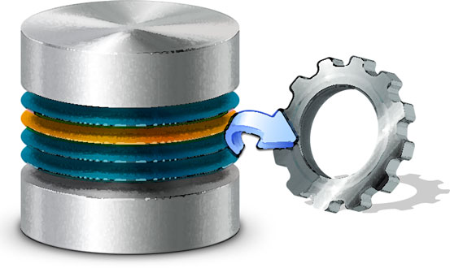
Trigger
MSSQL Trigger = Force.com APEX Trigger
Scope
Programmatic (Java-based)
Before or after insert, update, delete, undelete
Abilities
Change record fields before database commit
CRUD other fields / objects
Emails
SOAP / REST Callouts (utilizing APEX Classes)

Slide 14
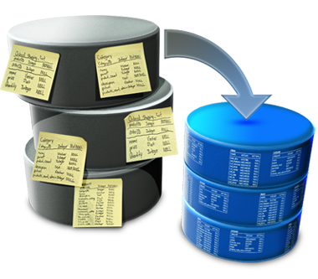
Index
MSSQL Index = Force.com Index
Standard Indexed Fields
Lead: Company, Email, Owner, Name
Contact: Account Name, Owner, Email, Name, Reports To
Account: Name, Owner, Record Type, Parent Account
Lookup relationships
System time fields
External Ids
Custom Indexing
Not immediately available, contact Support for options

Slide 15
View
MSSQL View = Good question!
Create a “view” custom sObject
Reports
Tablular format
3rd party integration
Jitterbit
dbAMP

Slide 16

Tools
But I’m used to Management Studio?
Native Salesforce Interface
All abilities available (sObjects, fields, validation rules, programmatic)
Schema Builder
Fully interactive “Database Diagram”
Force.com Workbench
workbench.developerforce.com
Developer Console
APEX Classes and Triggers

Slide 17
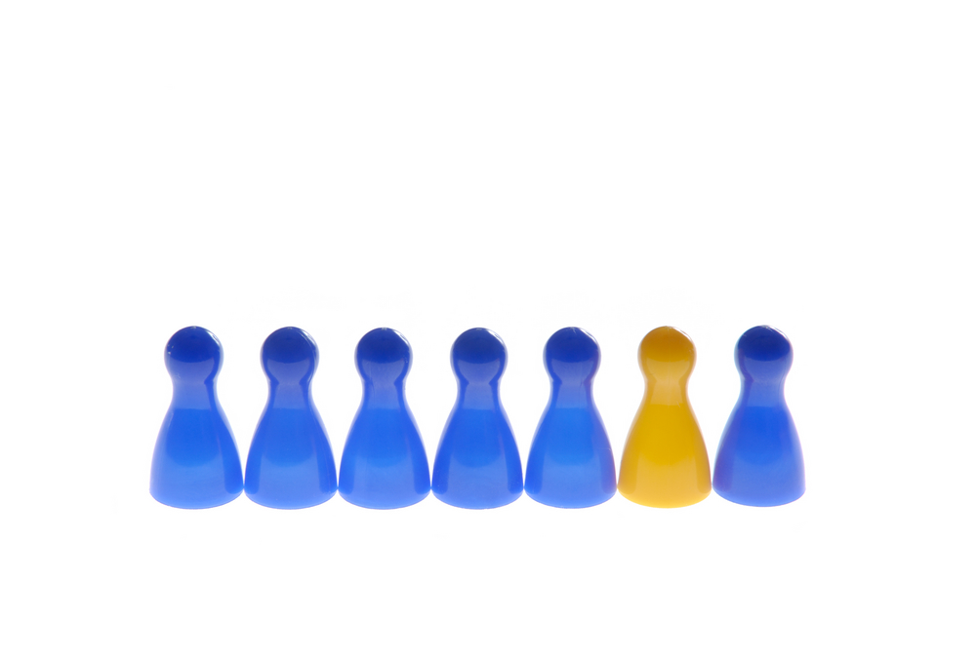
Tips and Tricks
What is different about building a Force.com schema?
Not much.
Still need to normalize
Still need to enforce a naming convention
Force.com helps maintain ids, names, and timestamps

Slide 18

Andy Boettcher
@andyboettcher
Twin Cities Developer User Group Leader

